Slide 1
Contactor Wireless Controlling
Roy Indra Rachmat

Slide 2
Kenapa ?
Mikrocontroller
Wireless
Smartphone

Slide 3
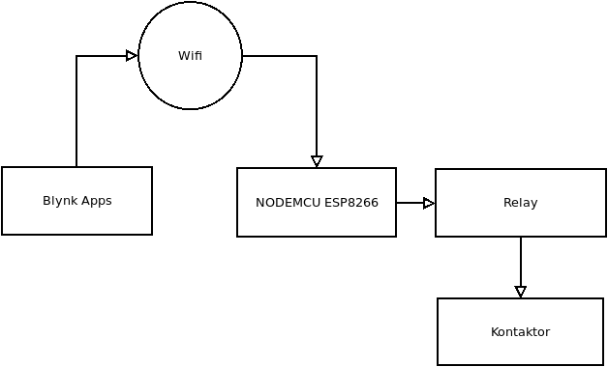
Blok Diagram

Slide 4
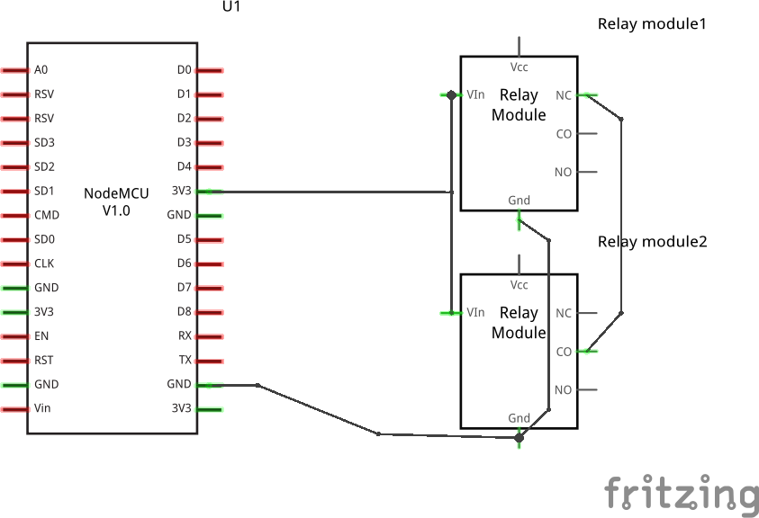
Skematik

Slide 5
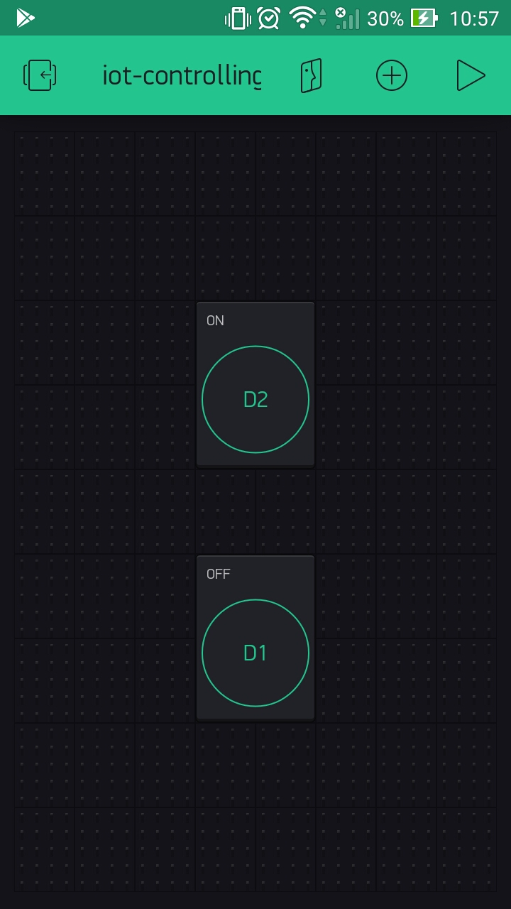
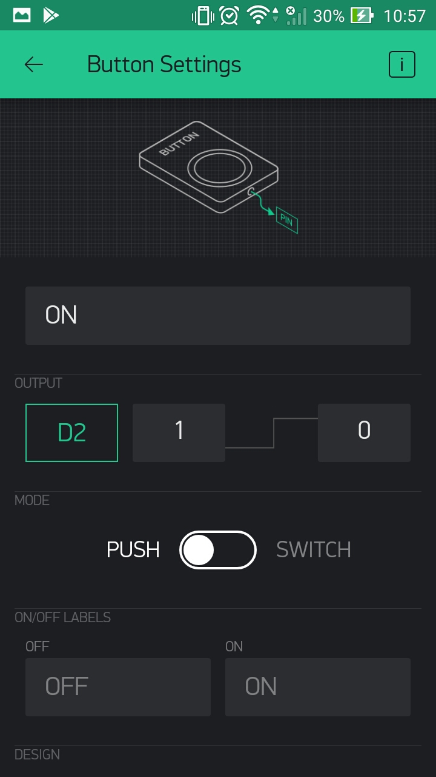
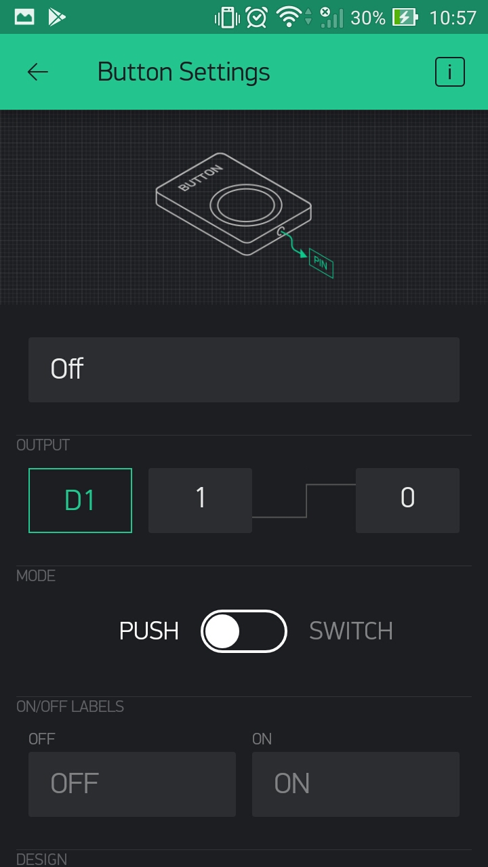
Blynk App

